Slide 1
Module 1 Introduction to project procurement
Mgmt 6063 – Project Procurement

Slide 2

Module agenda
Welcome!
Introductions
About the course
What is procurement?
What is project procurement?
Homework/evaluations
Notes:
Image https://www.sandler.com

Slide 3
Getting to know your professor

Slide 4

Tell us about yourself on the FOL Discussion Forum:
INTRODUCE YOURSELF
Notes:
Image https://thecomefordgroup.com/contact

Slide 5

Get to know each other
In-class groups of 4 or 5 or via the FOL discussion …
See if you can make a list of five distinct things you all have in common (exclude the obvious: program, college, etc.). It could be a love for dogs, travel to a particular location, favourite colour, preferred type of book, favourite sport, etc.)
Reminder: there is a lot of group work in this course….this is an opportunity to get to know each other and “look around” for “group mates.”
Notes:
Image retrieved from https://www.signupgenius.com/groups/get-to-know-you-games-icebreakers.cfm

Slide 6
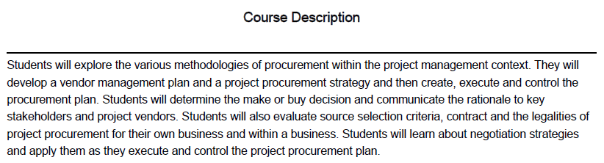
Course Description
(Also available on FOL)
We will focus on the processes and procedures associated with project procurement, aligning with enterprise strategy.

Slide 7
Course learning outcomes
Develop a vendor management plan
Develop a project procurement strategy
Plan, conduct, control and close the procurement
Determine the make or buy decision and communicate the rationale to key stakeholders
Issue a procurement request using the appropriate procurement document(s)
Participate effectively in contract negotiations
Respond effectively to external procurement requests from buyers

Slide 8
Course information on FOL
All course information is available on FOL. If you don’t know where to find something and you are stuck, ASK your professor.
Check the announcements section of the course FOL home page as a main way for your professor to communicate with you. It is your responsibility to read the announcements and, if needed, ask for clarification. Turn on auto-notification (to email) for announcements.
Anything identified with “FYI Only” is provided for interest only and it NOT part of course content.
Office hours are listed on FOL.

Slide 9
Course Overview and evaluations
The Course Overview provides the list of modules and topics, assigned reading and course evaluations. Go to FOL now to review it (at Getting Started/Course Overview).
Due dates for evaluations will be posted directly in the FOL course calendar.
You are responsible to complete assigned readings (and other materials) BEFORE the module class in which it applies.
Late submissions: Assignments worth less than10% of the course grade will NOT be accepted after the due date. Assignments worth 10% or more will receive a late penalty of 20% per day (24 hours) after the deadline.
Course evaluations:
Evaluation | % Grade
Group Assignments | 26%
Individual/Pair Assignments | 30%
Midterm Exam | 21%
Final Exam | 23%

Slide 10
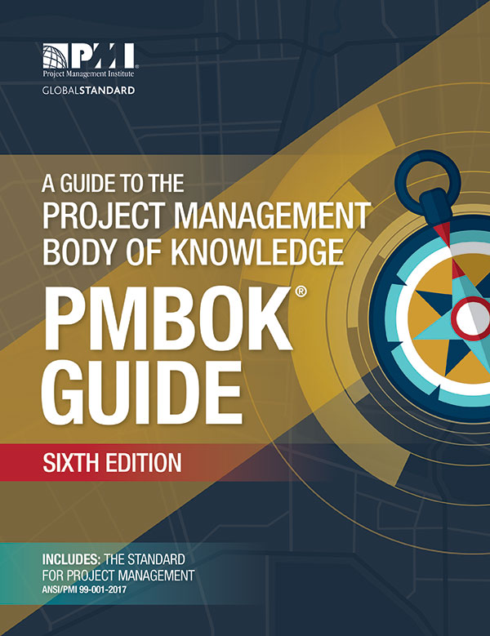
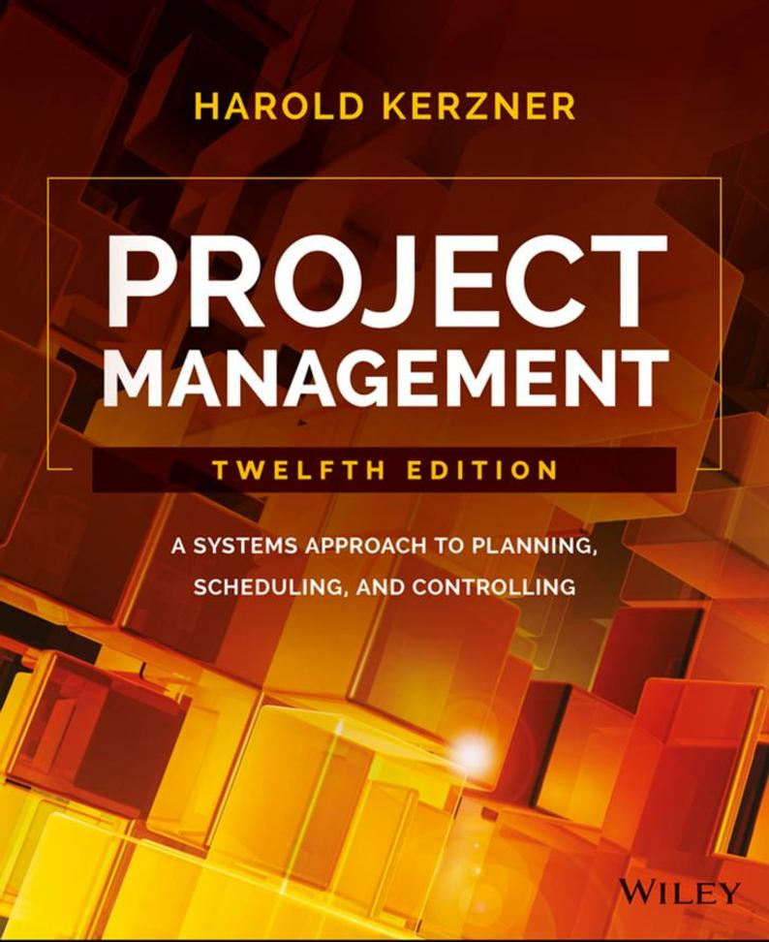
Course textbooks
1. A Guide to the Project Management Body of Knowledge (PMBOK® Guide) 6th Edition
Author/Publisher: Project Management Institute, Inc.
2. Project Management – A Systems Approach to Planning, Scheduling, and Controlling (12th Edition)
Author: Harold Kerzner; Publisher: Wiley
Ebooks available on FOL at Getting Started / Required Course and Technical Resources
3. LinkedIn: Yarbrough, O., Project Management Foundations: Procurement, LinkedIn Learning 2019
Notes:
Images vectorstock.com

Slide 11
Class expectations
If you ever have a problem or a question, contact your professor using name@fanshaweonline.ca. It is usually much easier to resolve potential issues early on – don’t wait until it is too late! Professors will generally respond within 24 hours but not on weekends/holidays.
Fanshawe Student Code of Conduct: https://www.fanshawec.ca/about-fanshawe/corporate-information/policies/its-about-choices

Slide 12
Class expectations
In this course, we focus on both the Vocational Learning Outcomes, and the Essential Employability Skills. Communication skills are essential for the program and your future career.
All written work must be written in correct English (i.e., punctuation, spelling, grammar, sentence structure).
You may be asked to rewrite a poorly written email. Poorly written assignments will result in lost marks.
Carefully follow assignment/project instructions including business document format unless instructed otherwise (i.e., title page, introduction, structured body with headings, conclusion, references).
Consider asking someone to proofread your work before submitting.

Slide 13
Academic accommodations
Contact your professor as needed.
Online evaluations (e.g., quizzes) will be set up with individual extended time requirements. Be sure to check the settings at least one day before the evaluation.
On-campus evaluations for academic accommodations may be written in the Testing Centre, but check with the Testing Centre first.

Slide 14
Academic offense policy
https://www.fanshaweonline.ca/shared/College_docs/02_College_Policy_Information.html
Addresses academic offences such as copying, plagiarizing, using unauthorized materials, obtaining exams prior to date.
May result in “0”, F in course, suspension or expulsion.

Slide 15
Citing your work in APA format
APA (American Psychological Association) style citation is required in this program
Guidance on FOL: https://www.fanshawelibrary.com/wp-content/uploads/2020/09/APA-7th-Edition-LLC-2020.pdf
Word has built-in functionality to assist with APA formatting

Slide 16
Citing Examples
In-Text Citation | Citing in References
Cognitive mapping is an analysis method using interviewing techniques to let the interviewee think through issues of strategy (Tyler, 2001). | Burns, T., and Smith, G. M. (1961). "The management of innovation." Associated Book Publishers, London, England.
McQueen (2002) has set out a generic model with.…….. | Lynn Johnston, L. (2005) "Partners for learning and performance" Retrieved July 17, 2008, http://cstd.typepad.com/
 | Morris, P. W. G. (2001). “Updating the project management bodies of knowledge.” Project Management Journal, 32(3) p. 21-31.

Slide 17


Group work
Group work can be challenging
The key to effective group work is communication and respect
Groups limited to 4 students. Check with your professor regarding the arrangements for the formation of groups.
Notes:
Images https://fl-edumaxi-media.s3.amazonaws.com/uploads/2017/05/23.-shutterstock_303168299.jpg and https://i.pinimg.com/originals/d1/bd/2e/d1bd2ed2f728979bb2ca2f1e2db4c0f1.png

Slide 18
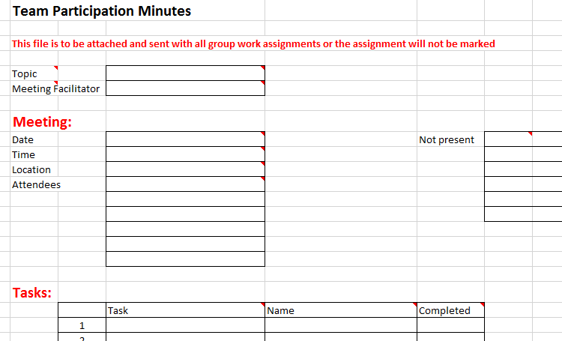
Group work
Group assignments require the submission of team participation minutes
Excel template is provided with first group assignment instructions

Slide 19

Any general questions about the course before we start with course material?
In-class, ask your professor. Online, capture any questions you have so far and make sure you either find your answer from other sources on FOL such as Course Announcements or email – or contact your professor.
Notes:
Image https://www.bodycentricwellness.co.uk/faq-questions-about-abc/

Slide 20


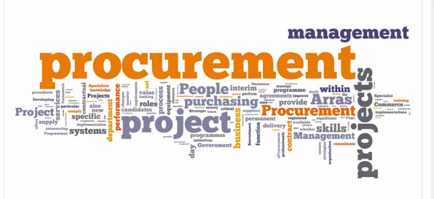
What is procurement? what is project procurement?
Procurement is the act of obtaining goods, supplies, and/or services.
Therefore, project procurement is obtaining the materials and services required for a project.
Project procurement management encompasses the processes used for making sure project procurement is successful.
Project Management: Procurement | working with procurement (1:53min). Click here.
Notes:
Image retrieved from https://planningengineer.net/project-procurement-terms-and-definitions/
Video https://www.youtube.com/watch?v=AxOeDE8cP8k

Slide 21
Major elements of procurement
Identification of requirements for procurement
Procurement vs make-your-own decision
Selecting contract types, and creating contracts
Identification of potential vendors
Evaluating/selecting vendors and their proposals
Monitoring and controlling procurements
Managing procurement contracts
Closing procurements

Slide 22
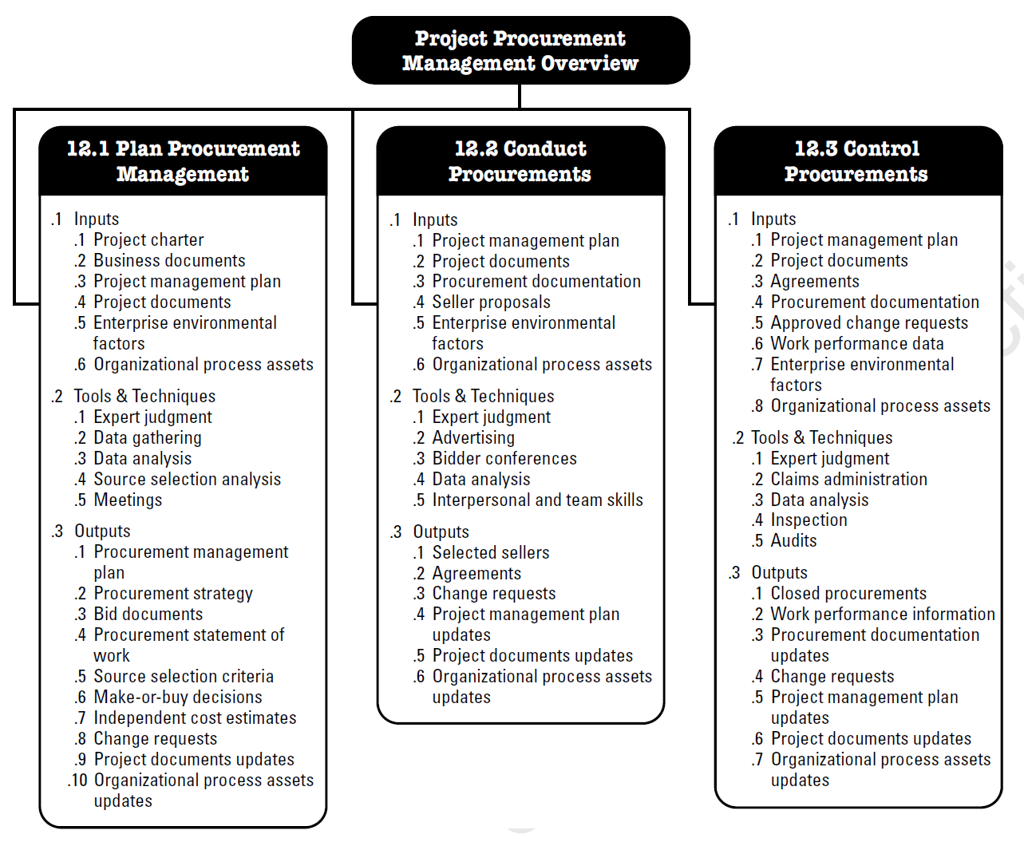
Pmbok - Project procurement management (Knowledge Area 12)
Plan
Do
Control
Notes:
Image - Project Management Institute, Inc., PMBOK Guide 6th Edition (2017)
Project Management Institute. (2017) A guide to the project management body of knowledge (PMBOK guide). Newton Square, Pa: Project Management Institute
Figure 12-1. Project Procurement Management Overview (page 460)
Project Procurement Management processes include the following:
Plan Procurement Management—The process of documenting project procurement decisions, specifying the
approach, and identifying potential sellers.
Conduct Procurements—The process of obtaining seller responses, selecting a seller, and awarding a contract.
Control Procurements—The process of managing procurement relationships, monitoring contract performance,
making changes and corrections as appropriate, and closing out contracts.
The procurement processes are presented as discrete processes with defined interfaces.

Slide 23

Questions to ask when preparing a project procurement plan
What are the materials, resources, services needed for the project?
What can you provide “in-house” rather than through a seller?
When do you need contracts executed?
What type of contract do you want with the seller?
What is the role of the PM vs the procurement department?
How do you determine a “good” supplier?
How do you know which supplier has the best offer?
What are the risks of procurement for this project?
Notes:
Image retrieved https://www.inc.com/jim-haudan/20-questions-to-make-meaningful-connections.html
The Project Procurement Management processes involve agreements that describe the relationship between two parties—a buyer and a seller. Agreements can be as simple as the purchase of a defined quantity of labor hours at a specified labor rate, or they can be as complex as multiyear international construction contracts.

Slide 24
Procurement and the project management plan
We build our Project Management Plan addressing PMBOK Knowledge Areas including scope, time/schedule, cost, risks, stakeholders and
quality
As we build our overall plan including creating a WBS and identifying activities, we start targeting areas for procurement such as: subcontractors, materials, equipment, and services

Slide 25
Procurement and the project management plan
Procurement management is frequently a key part of the overall project management plan. An exception might be an internal IT project with no outside contractors involved.
Our schedule in our project management plan would help determine the timing of our procurement and the schedule for delivery of the procured materials, services and resources
We may create a WBS and not identify activities, but rather rely on the contractor to determine the “how”.

Slide 26







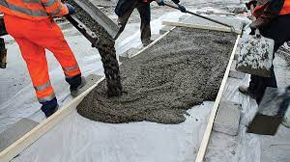
Procurement and the project management plan
In some cases, almost all the work for a project could be outsourced to a contractor/subcontractors.
New house construction project
Subcontracted work
Builder/contractor hired by home owner
Notes:
Images moving.com https://www.womeninconstructionsummit.com/blog/where-are-all-the-female-construction-workers cen.acs.org zeelandlumber.com www.thisoldhouse.com prowess.org.uk https://www.greenscenelandscaping.ca/blog/6-things-look-choosing-landscaper/ http://www.airfactoryokc.com/

Slide 27
Procurement examples
Individually or in groups: choose one project below and provide three possible examples of procurement.
Project Description | Three Examples of Procurement
Example: Fanshawe College is planning to build a new student residence building on campus. | Design consultant for design of building; contractor for construction of building; furniture for dorm rooms and common areas
Company XYZ needs an advanced employee management system since expanding to an international organizational structure
Your wedding planned for next summer
Canada’s Olympic committee is preparing the bid for the 2034 Winter Olympics

Slide 28
Procurement terminology
Examples of procurement, legal, and contract terms:
amendment
arbitration
breach of contract
debrief
decision point
direct award
force majeure
good faith
holdback
negligence
intellectual property
mandatory criteria
penalty clause
posting period
decision point
proponent
sole source award
waiver
We will go into more detail in later modules.

Slide 29

assumptions
Buyer (or Purchaser or Acquiring Organization)
Might be a buyer assigned to the project team and/or part of the larger organization
Seller (or Vendor or Contractor)
Provide goods and/or services to the project
Usually outside the organization
In very small organizations and on small projects, the project manager might perform the role of the buyer.
Notes:
Image https://cdn.thomasnet.com/insights-images/9203b6bf-69e1-40a9-b7aa-18d7ae007f9a/750px.png

Slide 30

Agreements/contracts
Describe relationship between buyer and seller including deliverables and results
Can include significant legal obligations and penalties
Comply with local, national and international contract laws
More extensive approval process
Are tailored to the project
Anything not in the contract cannot typically be legally enforced
See Slide Notes
Notes:
Image ebaengineering.com
A contract should clearly state the deliverables and results expected, including any knowledge transfer from the seller to the buyer. Anything not in the contract cannot be legally enforced.
When working internationally, project managers should keep in mind the effect that culture and local law have upon contracts and their enforceability, no matter how clearly a contract is written.
Most organizations document policies and procedures specifically defining procurement rules and specifying who has authority to sign and administer such agreements on behalf of the organization.
Across the world, organizations use different names for departments or divisions that deal with procurement, such as purchasing, contracting, procurement, or acquisitions; however, the responsibilities are likely to be similar.
Although all project documents may be subject to some form of review and approval, the legally binding nature of a contract means it will be subjected to a more extensive approval process, often involving the legal department. In all cases, the primary focus of the review and approval process is to ensure that the contract adequately describes the products, services, or results that the seller is agreeing to provide, while being in compliance with the laws and regulations regarding procurements. These sections are often separate appendices or annexes, allowing standardized legal contract language to be used.
As a project manager you shouldn’t be signing any of the legal documents, it is recommended that you understand the legalities pertaining to the contracts so you can flag it to upper management if you notice anything off. Higher ups within the organization are responsible for signing these legally binding contracts.

Slide 31
Trends and emerging practices
Online tools provide a single point for buyers and sellers to interact (example: https://london.bidsandtenders.ca/Module/Tenders/en)
Contracts include specific risk information to protect both buyer and seller
Nationally/internationally recognized standard contract forms are being used to reduce disputes during execution (example: https://www.ccdc.org/)
Logistics and supply chain management tailored to the specific needs of the project
Stakeholder management especially in publicly-funded projects
Trial engagements as a final step in the selection process
See Slide Notes
Notes:
There are a number of major trends in software tools, risk, processes, logistics, and technology with different industries that can affect the success rate of projects.
Trends and emerging practices for Project Procurement Management include but are not limited to:
Advances in tools – Online tools for procurement now give the buyers a single point where procurements can be advertised and provide sellers with a single source to find bid documents and complete them directly online. Within the construction/engineering/infrastructure field, the increasing use of the building information model (BIM) in software tools has been shown to save significant amounts of time and money on projects using it. This approach can substantially reduce construction claims, thereby reducing both costs and schedule. Major companies and governments worldwide are beginning to mandate the use of BIM on large projects.
More advanced risk management – Risk management is something that can be avoided within a project if you write contracts that accurately allocate specific risks to those entities most capable of managing them. This is something that will come to you as a project manager by practice and experience because you will be able to draw back from previous project you have worked on and by understand the specific industry you are in. No contractor is capable of managing all the possible major risks on a project. The team will need to accept and understand these risks, what is important is to provide a solution to the problem instead.
Changing contacting processes – There has been a significant growth in megaprojects in the past several years, particularly in the areas of infrastructure development and engineering projects. Projects with big budgets now adays are more common, which involves many different contractors from different countries. This can be riskier than using local contractors. the contractor works closely with the client in the procurement process to take advantage of discounts through quantity purchases or other special considerations. For these projects, the use of internationally recognized standard contract forms is increasing in order to reduce problems and claims during execution.
Logistics and supply chain management – Because so many large engineering, construction infrastructure projects are done through multiple international contractors, the management of the flow of materials becomes critical to successful completion. It is important to understand the lead time for items required for the project. Long-lead items may be procured in advance of other procurement contracts to meet the planned project completion date. It is possible to begin contracting for these long-lead materials, supplies, or equipment before the final design of the end product itself is completed based on the known requirements identified in the top-level design.
Technology and stakeholder relations – Technology is being utilized in order to keep projects on track, specifically web cams during the construction process. This allows the stakeholders to monitor the progress of the project. Video data can also be stored, allowing analysis if a claim arises. Some projects have discovered that the use of webcams minimizes disputes relating to the construction work on site, as the webcam has recorded the events, so there should be no disagreement about the facts of the matter.
Trail engagement – This allows organizations understand the suppliers work process as not every seller is well suited for an organization’s environment. Therefore, some projects will engage several candidate sellers for initial deliverables and work products on a paid basis before making the full commitment to a larger portion of the project scope.

Slide 32
Tailoring considerations
Project procurement tailoring could be performed for each project in your organization based on:
Complexity
Volatility of the project
Dollar value of the procurement
Physical location(s)
Governance and regulatory environment
Availability of sellers capable of supplying the required goods and/or services
See Slide Notes
Notes:
Because each project is unique, as a project manager you may need to tailor the way that Project Procurement Management processes are applied.
Complexity of procurement – Is there one main procurement or are there multiple procurements at different times with different sellers that add to the complexity of the procurements?
Physical location – Are the buyers and sellers in the same location, or reasonably close, or in different time zones, countries, or continents?
Governance and regulatory environment – Are local laws and regulations regarding procurement activities integrated with the organization’s procurement policies? How does this affect contract auditing requirements?
Availability of contractors – Are there available contractors who are capable of performing the work?

Slide 33
Summary of our journey today
Course overview
Introduction to project procurement
Key procurement concepts
Overview of generic project procurement

Slide 34
Homework and evaluations
Readings for next module as listed in Course at a Glance

Slide 35
references
Project Management Institute (2017). A Guide to the Project Management Body of Knowledge (Sixth Edition).
Kerzner, Harold (2017). Project Management, Twelfth Edition.
Watts, A. (2014). Project Management. Victoria, B.C.:BCcampus. Retrieved from https://opentextbc.ca/projectmanagement/.

